Slide 1


Large scale network analysis of Twitter data
Big Data Platforms,
Final Project
Ishani Tagore | imajumd0
ID: 12328771

Slide 2



Executive summary
Our goal was to understand:
“Is Twitter a credible source of information on emerging trends and topics in the field of education?”
OUR UNDERSTANDING OF THE PROBLEM
Twitter could be a valuable source of leading indicators on emerging topics. But it is susceptible to misinformation. Sensational content easily gains attention. Fake accounts inflate followers. And, moderating in real-time is a challenge.
OUR APPROACH
We want to critically evaluate Twitter’s credibility as a valid source of information on education events and trends. We focus on the user layer of Twitter (not tweet topics), and use PySpark, Graphframes, Geopandas and Jaccard similarity to analyze credibility.
SO WHAT?
Better understanding the dynamics and credibility of Twitter could help analysts, policy makers and my Mom, who is constantly in need of rescuing from conspiracy theories.
It can also guide efforts to identify the hubs of original content on the platform, understand the impacts of of influencers, and see how these patterns change with significant events and across clusters of Twitterers.

Slide 3
Methodology & source data overview
The analysis focuses on a collection of Twitter data pulled from the Twitter API, comprising ~100M tweets related to education, schools, universities, learning, and knowledge sharing.
METHODOLOGY
Remove fake accounts
Select topic subsets
Compare patterns across subsets
Discover hubs of influence in the overall network
Identify hubs of original content in the network
We removed empty user profiles and accounts for which the friends : followers count > 30 since this is a widely-studied attribute of fake profiles.
See slide 4.
Our pre-selected subsets only captured 7% of the overall data, so we zoomed out to the overall data, creating graph of ‘who retweets who. ‘ We analyzed network degree and pagerank to assess hubs of influence.
See slide 7.
Lastly, we excluded retweeted tweets, and analyzed the rest to understand which group was creating the most original content by using Jaccard distance to identify “unique tweets.”
See slide 8.
Acknowledging that the network overall might behave differently than sub-clusters, we opted to analyze edtech, school safety and black history focused subsets. We looked for relevant keywords in tweets to create these subsets.
See slide 4 for keywords.
Within each subset, we analyze volumes of tweets over time to look for spikes. We use rules to map users to account type and see how this varies within each subset. We also noted how overall patterns of activity and followers differ between subsets and the overall data.
See slides 5 – 6 and 9.
Notes:
Main steps:
* Clean out the fake bots
How did you break up the datasets. Found LDA topic modeling to be a failure with 1 gram. So with a preselected approach
Break into specific topic focused subsets of the data:
Observing reactions to predetermined events
Observing most followed within these subsets - Segment users by org type using XYZ rules
Observing uniqueness within these subsets of the data
Subsets captured 5% of the cleaned data, so we conducted graph analysis to discover where the hubs of activity are:
Calculating network degree and pagerank
Calculating similarity to understand the sources of original content within the Netflix >> similarity is not the best m measure of originality for twitter.

Slide 4
To handle “twitter bots”, Tweets were pruned & filtered. This also improved performance
We began with 100M tweets from the education domain but filtered out millions by focusing on English tweets.
We also searched for keywords like schools or remote learning within the tweet text itself to catch topics likely to be event or trend-driven. In our downstream analysis, we found topic-focused subsets of tweets more insightful and have shown some of the analyzed subsets to the right.
Filtering out ‘bots’ and ‘fake profiles’ provided the highest lift in reducing data size. We removed profiles that were blocked, muted or had profile pictures missing.
Most importantly, we removed tweets for which the friends_count : followers_count ratio > 30. Research on characteristics of fake accounts shows bots are focused on gathering friends, while regular users had ratios closer to 1.
100M
Education-focused tweets
73.4M
English-language tweets with keywords: schools, education, student, k12, highered, book ban, teachers union, remote teaching, remote learning, school reopen,
0.6M
Tweet data with noise (e.g., nulls) and fake accounts removed produces 617,842 tweets
#Edtech
#OnlineLearning
#StudentLoans
#SchoolSafety
#BlackHistory
1901
5972
6548
15159
15443
Notes:
617842

Slide 5
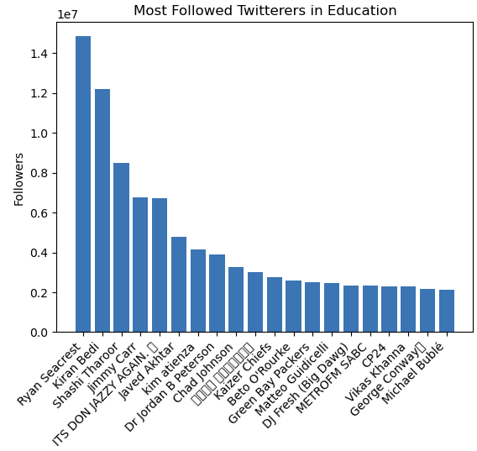
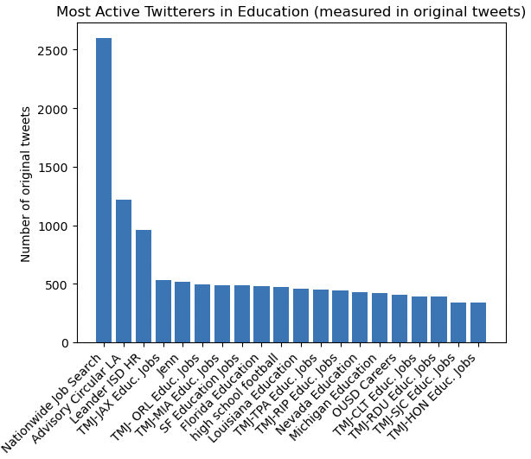
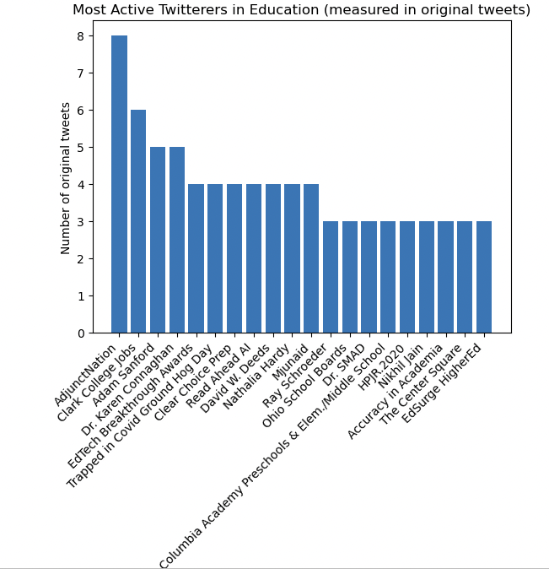
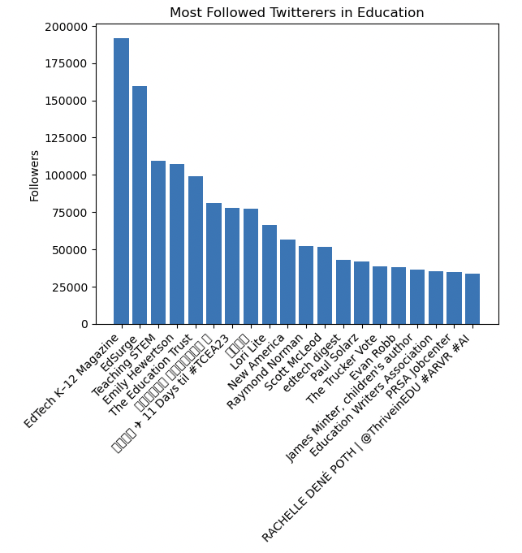
Author identification (1/3)
Most Followed
(in education overall - ’10M s)
Most Active (by tweet volume, excluding retweets)
(in education overall)
(in edtech & online learning)
(in edtech & online learning)
Looking at tweet and follower volumes overall paints a different picture than a topic-focused subset of tweets. Twitter activity in education overall is dominated by job boards, while the subset of edtech and online learning tweets are dominated by edtech influencers trying to improve reach.
Similarly, Ryan Seacrest and Michael Bublé are among the top followed overall, because they are heavily followed even outside the education domain but have education foundations. For the edtech subset, more niche edtech news and non-profits representing teachers’ interests are followed.

Slide 6
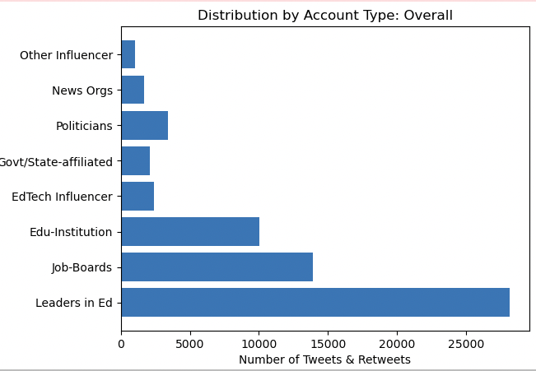
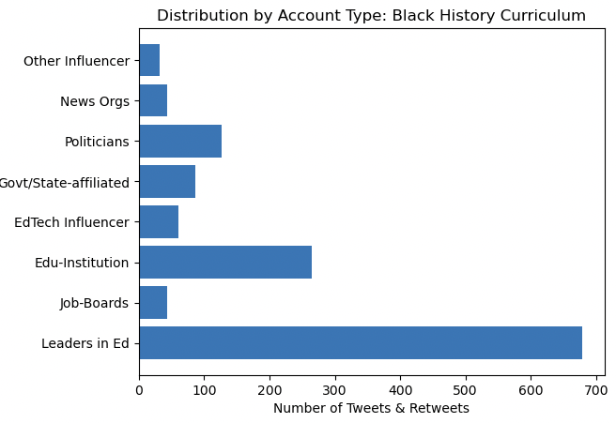
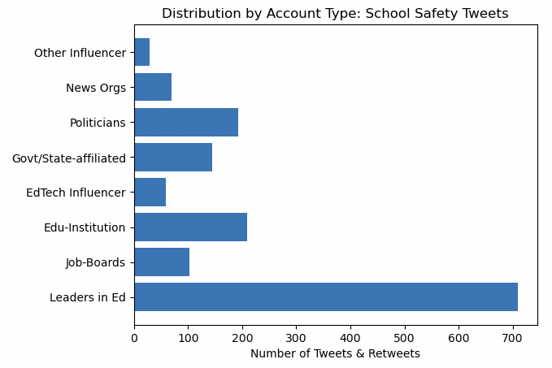
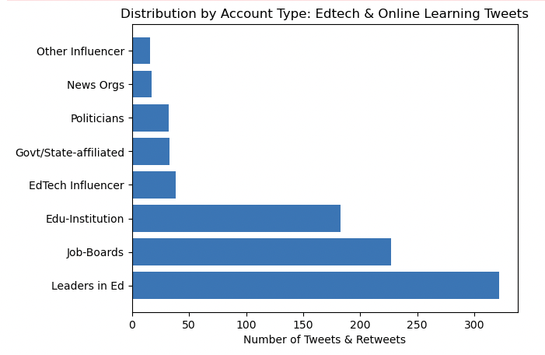

Topic: Overall
Topic: Black History
Author identification (2/3)
Who is being most vocal on Twitter appears to differ from the overall pattern if the topic is politically driven. In the Black History and School Safety subsets of tweets, politicians tweeted more and job board noticeably less.
Surprisingly, Leaders In Education (those with professional titles like superintendent or provost) were the most vocal across all analyzed subsets of tweets, while edtech influencers (coaches, consultants, speakers, authors etc.) were a minority.
Topic: School Safety
Topic: Online Learning

Slide 7
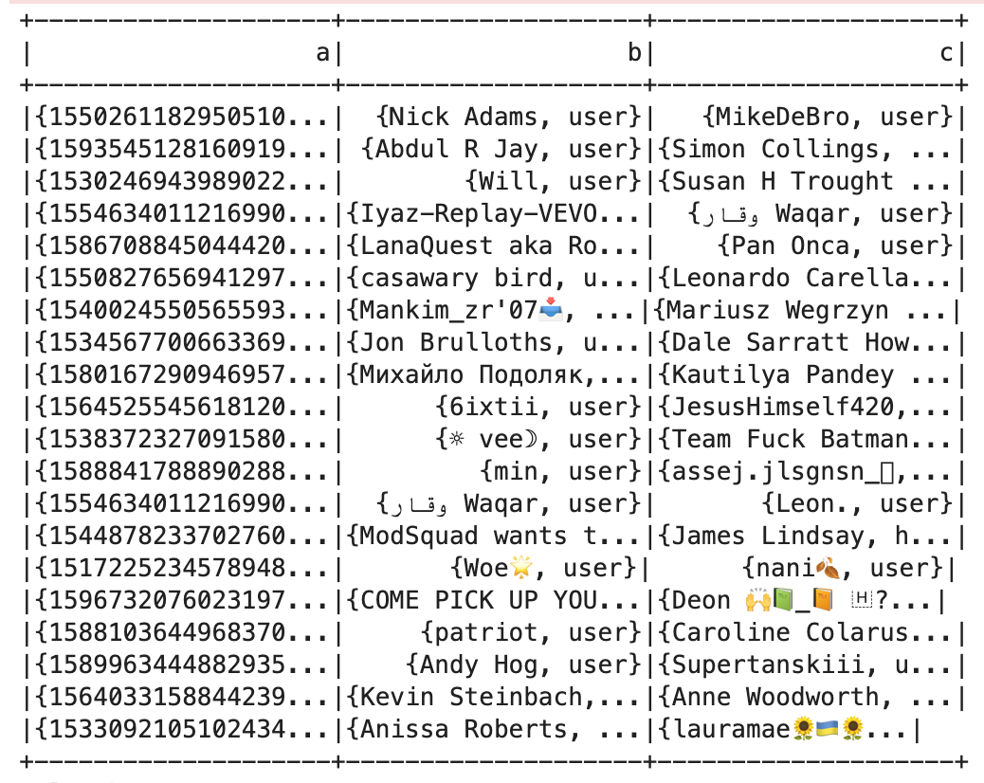
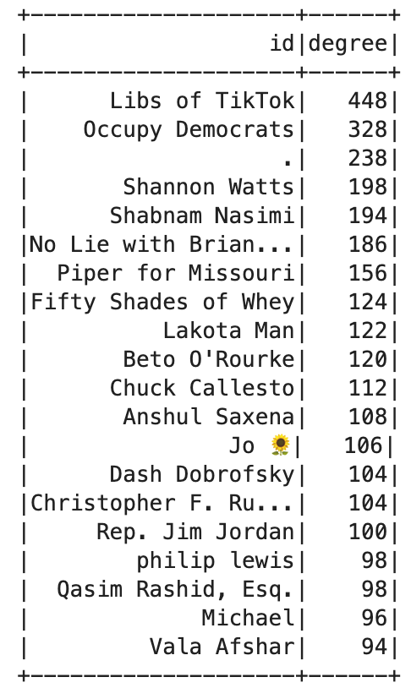
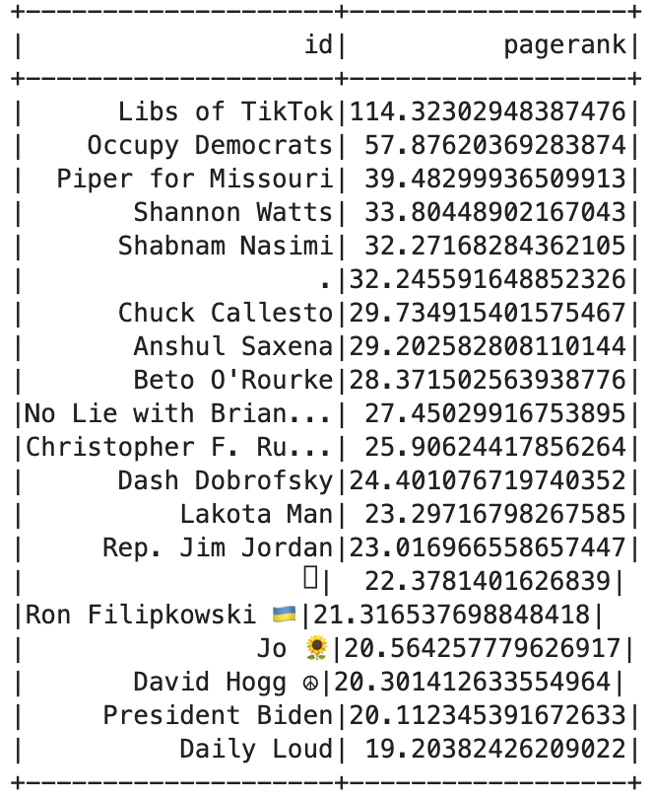
Retweet analysis using graphframes
Visualizing Retweets as a graph allows us a granular view on the ultimate source of retweets.
It also gives a bidirectional view into who is retweeting who.
Above, we graphed all the who-retweeted-who pairs associated with each tweet
When looking at ‘degree’, or the number of connections a user has with the network, we see the power law in play: 90% of users have a degree of less than 6
The top 10% percent is dominated by politicians and political activists focused on gun violence, Afghan schools and transgender issues
Pagerank considers both users being highly retweeted and the importance of those retweeting the same user.
‘Libs of Tiktok’ far outstrips other users in pagerank because hundreds of users contribute posts to the account, and influential Twitterers likely retweet these posts

Slide 8
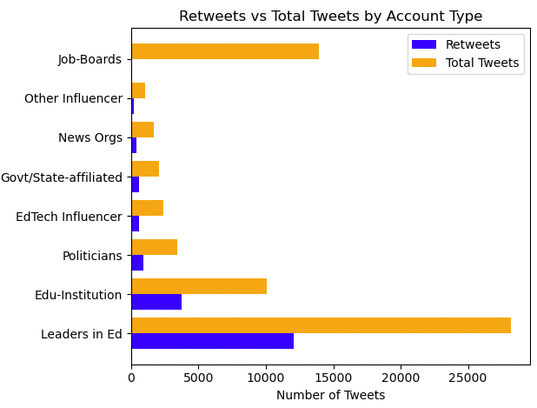
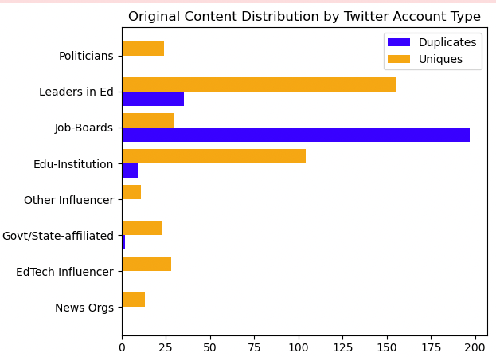
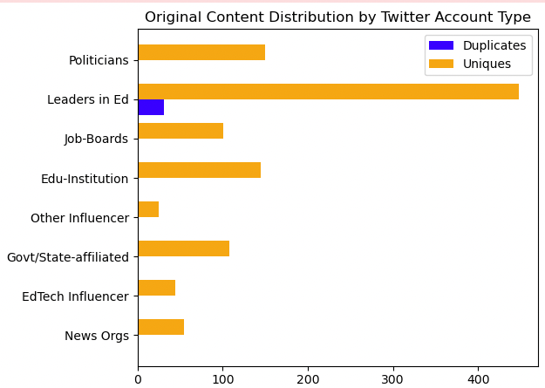
Who posts original content? (Message uniqueness using jaccard similarity)
Retweets vs Total Tweets
(Overall dataset)
Similarity within non-Retweets
(Subset of edtech & online learning tweets)
Similarity within non-Retweets
(Subset of gun violence tweets)
Leaders in education and educational institutions produce the most original tweets by volume. Going from left to right, we see ‘leaders in ed’ have the highest share of non-retweets. Next, a similarity search on the non-retweets alone shows a high volume of original content relative to others.
Job boards do not retweet anyone else, but have the highest amount of duplication, presumably because job postings come from the same source.
Edtech influencers and news organizations, although small in volume, are largely original across all the content they produce.

Slide 9
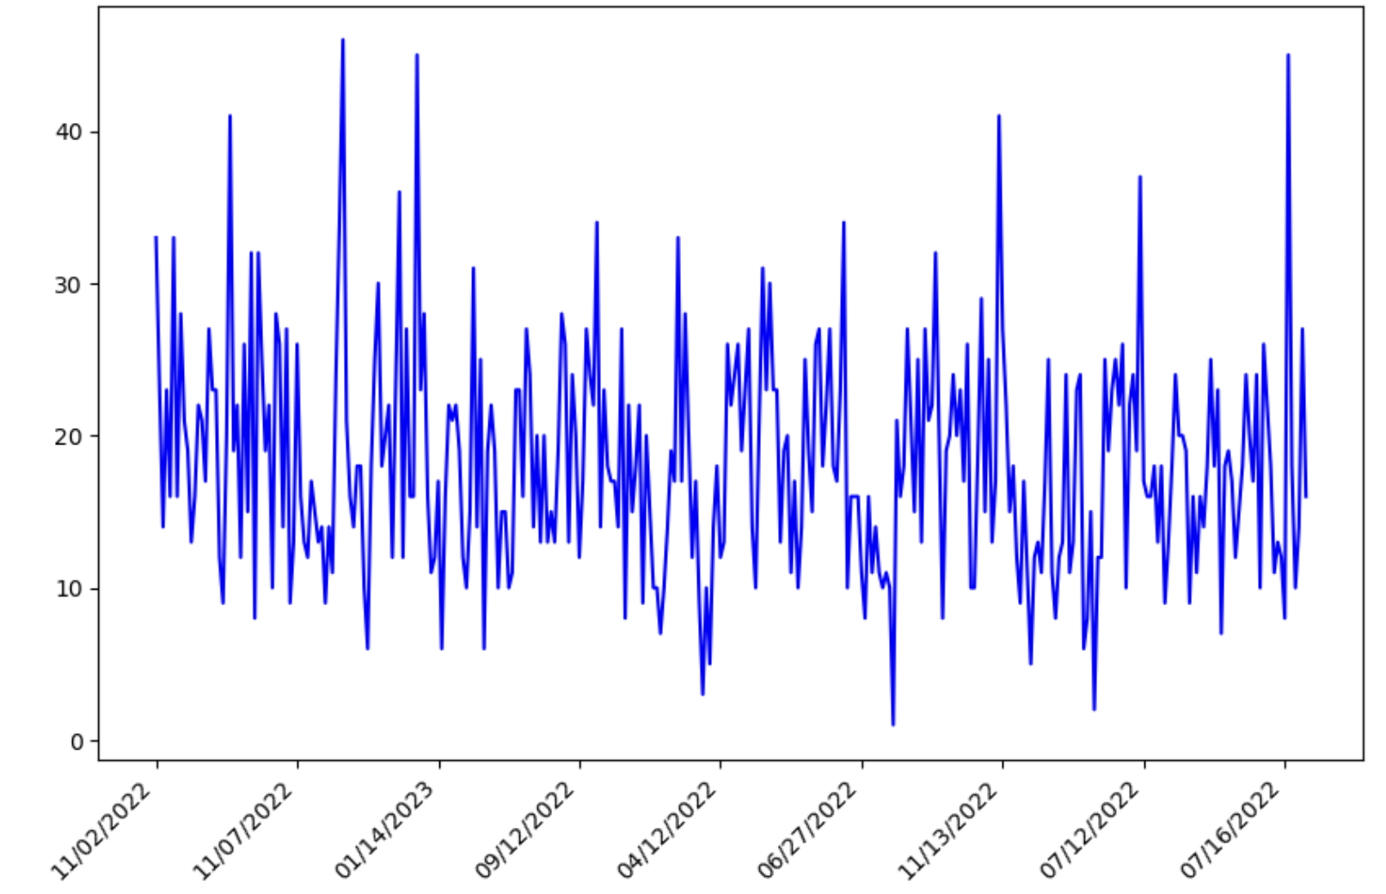
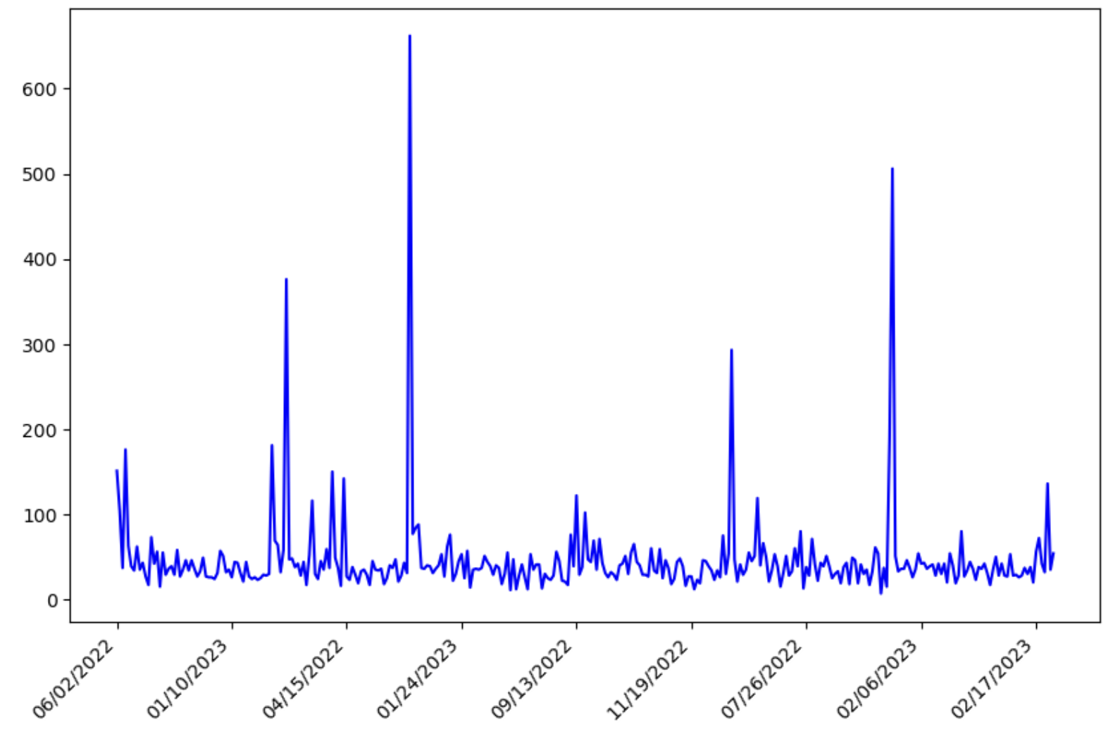
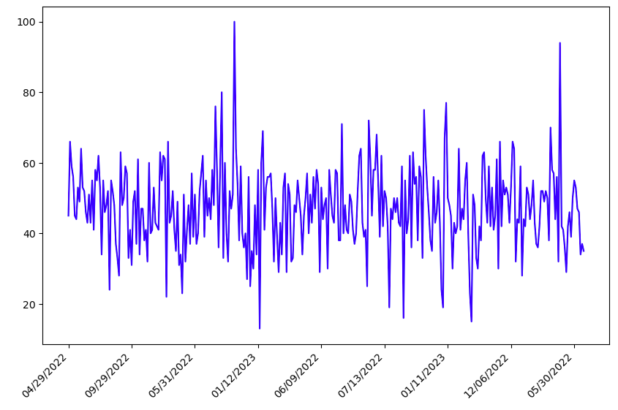
Timelines:
Edtech / Online Learning
School Violence
Black History
While school-safety tweets are event-driven, directly correlated with school shootings such as Uvalde on 24 June, 2022, black history and edtech-focused tweets reflect more consistent trends.
Surprisingly, the majority of tweets in the aftermath of the Uvalde shooting were not from edtech influencers or journalists, but from the many non-influential accounts. They express outrage, but do not offer facts. They serve as useful signals of sentiment, but not fact.

Slide 10
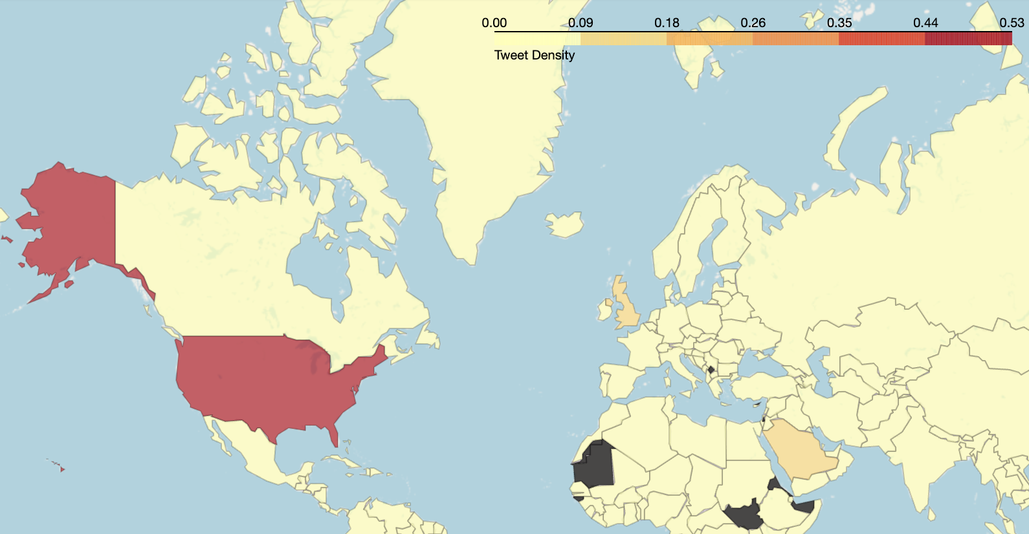
location analysis
Plotting tweet locations prior to fake bot removal shows that most English-speaking tweets are from the US, but that Saudi Arabia and the UK also contribute volume. Surprisingly, Canada and India do not.
A location analysis of tweets just after events like the Uvalde shooting is not insightful. 66% of tweets across the edtech, school safety and black history subsets are from CA, TX, FL and WA and often do not represent the localities in which events occur.

Slide 11
Conclusions & Recommendations
Twitter – A Credible Source on Trends?
Recommendations & Next Steps
Overall, Twitter appears to be more a forum for opinions and discussion about events than it is a leading indicator of emerging trends or a platform for diverse perspectives on news stories:
Political tweets related to school shootings and book bans, for example, outnumbered online learning tweets by 3x, both overall and in daily activity.
Job boards form the top 20 most active accounts, and celebrities and politicians are the top 20 most followed, with followers exceeding 2M.
When we zone into specific topics within education e.g., school safety, edtech, Twitter is insightful:
Tweet similarity analysis tells us that a large majority of tweets (non-retweets) are unique among educational leaders and influencers. This makes sense given most tweets are individual opinions about events.
Spikes in tweet volume directly sync with school shootings, for example, and reflect expressing grief and outrage in unique ways.
Network analysis shows that the hubs of the network are accounts where many users contribute content about local events and everyday observations not found in the news (Libs of Tiktok). These in turn are retweeted by influential Twitterers - especially if it furthers the political messages dominating conversation on Twitter.
Individuals curating their Twitter feeds for insights in the education space should:
Follow niche topics of interest and influencers within these topics (who have 12.5K – 25K followers) because the “noise” that characterizes Twitter (job postings, politics) is removed in these niches.
Follow accounts that crowdsource contributions from multiple users. These can be a source of local insights and everyday observations not covered by the news.
Use Twitter for sentiment analysis as opposed to an alternative source of fact-based journalism. Spikes in message volume comprise emotional responses to news events, providing a valuable indicator of national sentiment.
In this analysis, we pre-selected topics to subset the data, but for a further analysis, we suggest discovering topics using unsupervised learning:
Subletting the data by topic using LDA may provide more insight than just focusing on the user layer, as we have done.
Our effort at a 1-gram LDA on user descriptions did not yield insight, so we suggest tri-gram based unsupervised clustering to discover topics.

